Slide 1


Adarsh Institute of Technology & Research Centre, Vita Department of Computer Science & Engg Class-TY(B.Tech)
Mini- Project Presentation on
“Health Care Management System”
Presented by :
Nikita Sanjay Bhosale CS3057
Payal Randhirsing Jamdar. CS3058
Manisha Arjun Gaikwad. CS3059
Shreya Popat Karade. CS3060
Academic Year
2023-2024
Under Guidance of
Mr.S.S.Lad

Slide 2
INDEX:
Introduction
Relevance of the Work
Proposed Work
Proposed Methodology
Literature Review
HW/SW Requirement
Flowchart
References

Slide 3
Introduction
Health care management system is a web application developed for hospitals to manage staff data and patients data effectively. the main aim of developing “HEALTH CARE MANAGEMENT SYSTEM” is to computerize the Front Office Management of Hospital. Hospital Management.
The project Hospital Management system includes registration of patients, storing their details into the system, and also computerized billing in the pharmacy, and labs. Healthcare is a field in which accurate record keeping and communication are critical. The software has the facility to give a unique id for every patient and stores the details of every patient and the staff automatically.
It deals with the collection of patient’s information, diagnosis details, etc. It includes a search facility to know the current status of each room. User can search availability of a doctor and the details of a patient using the id.

Slide 4
Relevance of the work
Enhanced Efficiency
Improved Patient Care
Enhanced Communication and Collaboration
Data-Driven Decision Making
Regulatory Compliance and Security

Slide 5
Proposed work
Define objectives
Identify key features
Assemble a skilled team
Gather user feedback
Test and quality assurance

Slide 6
Proposed methodology
Requirement gathering
System design
Development

Slide 7
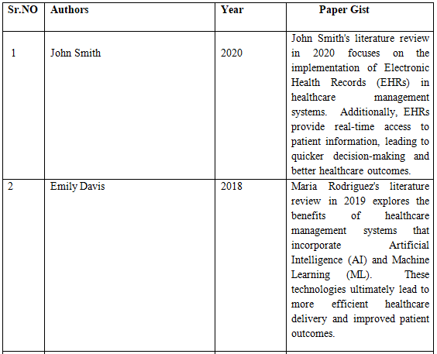
Literature review

Slide 8
3 | Maria Rodriguez | 2018 | Maria Rodriguez's literature review in 2019 explores the benefits of healthcare management systems that incorporate Artificial Intelligence (AI) and Machine Learning (ML).predict disease outbreaks, optimize resource allocation, and personalize treatment plans. These technologies ultimately lead to more efficient healthcare delivery and improved patient outcomes.

Slide 9
Hw/sw requirement
Hardware:
256MB Ram
512 KB Cache Memory
Hard Disk 10 GB
.
Software:
Windows xp
Operating system
Programing Language C

Slide 10
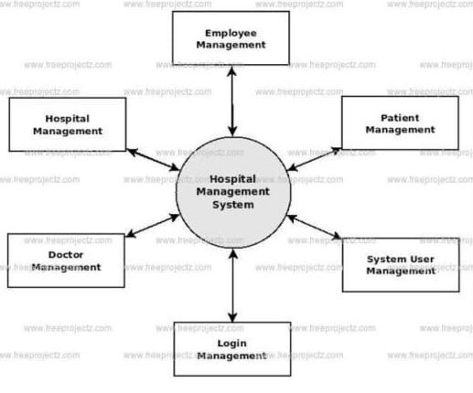
flowchart

Slide 11
conclusion
In conclusion, the researchers found that the system could speed up the working progress and productivity of hospital employees. It could also generate hospital reports that could help the users to provide an overview of the hospital transaction within specific date.

Slide 12
Reference
a)Wikipedia(n.d).Mbarara_Hospital.RetrievedSeptember27th,2010,from http://www.wikipedia.org:htttp://www.wikipedia.org/wiki/Mbarara__Hospital
b)Support.microsoft.com
c) Advance C Programming Oxford Publisher 2010

Slide 13
Thank You

